Slide 1
1861: The Country Goes to War
The American Battlefield Trust

Slide 2
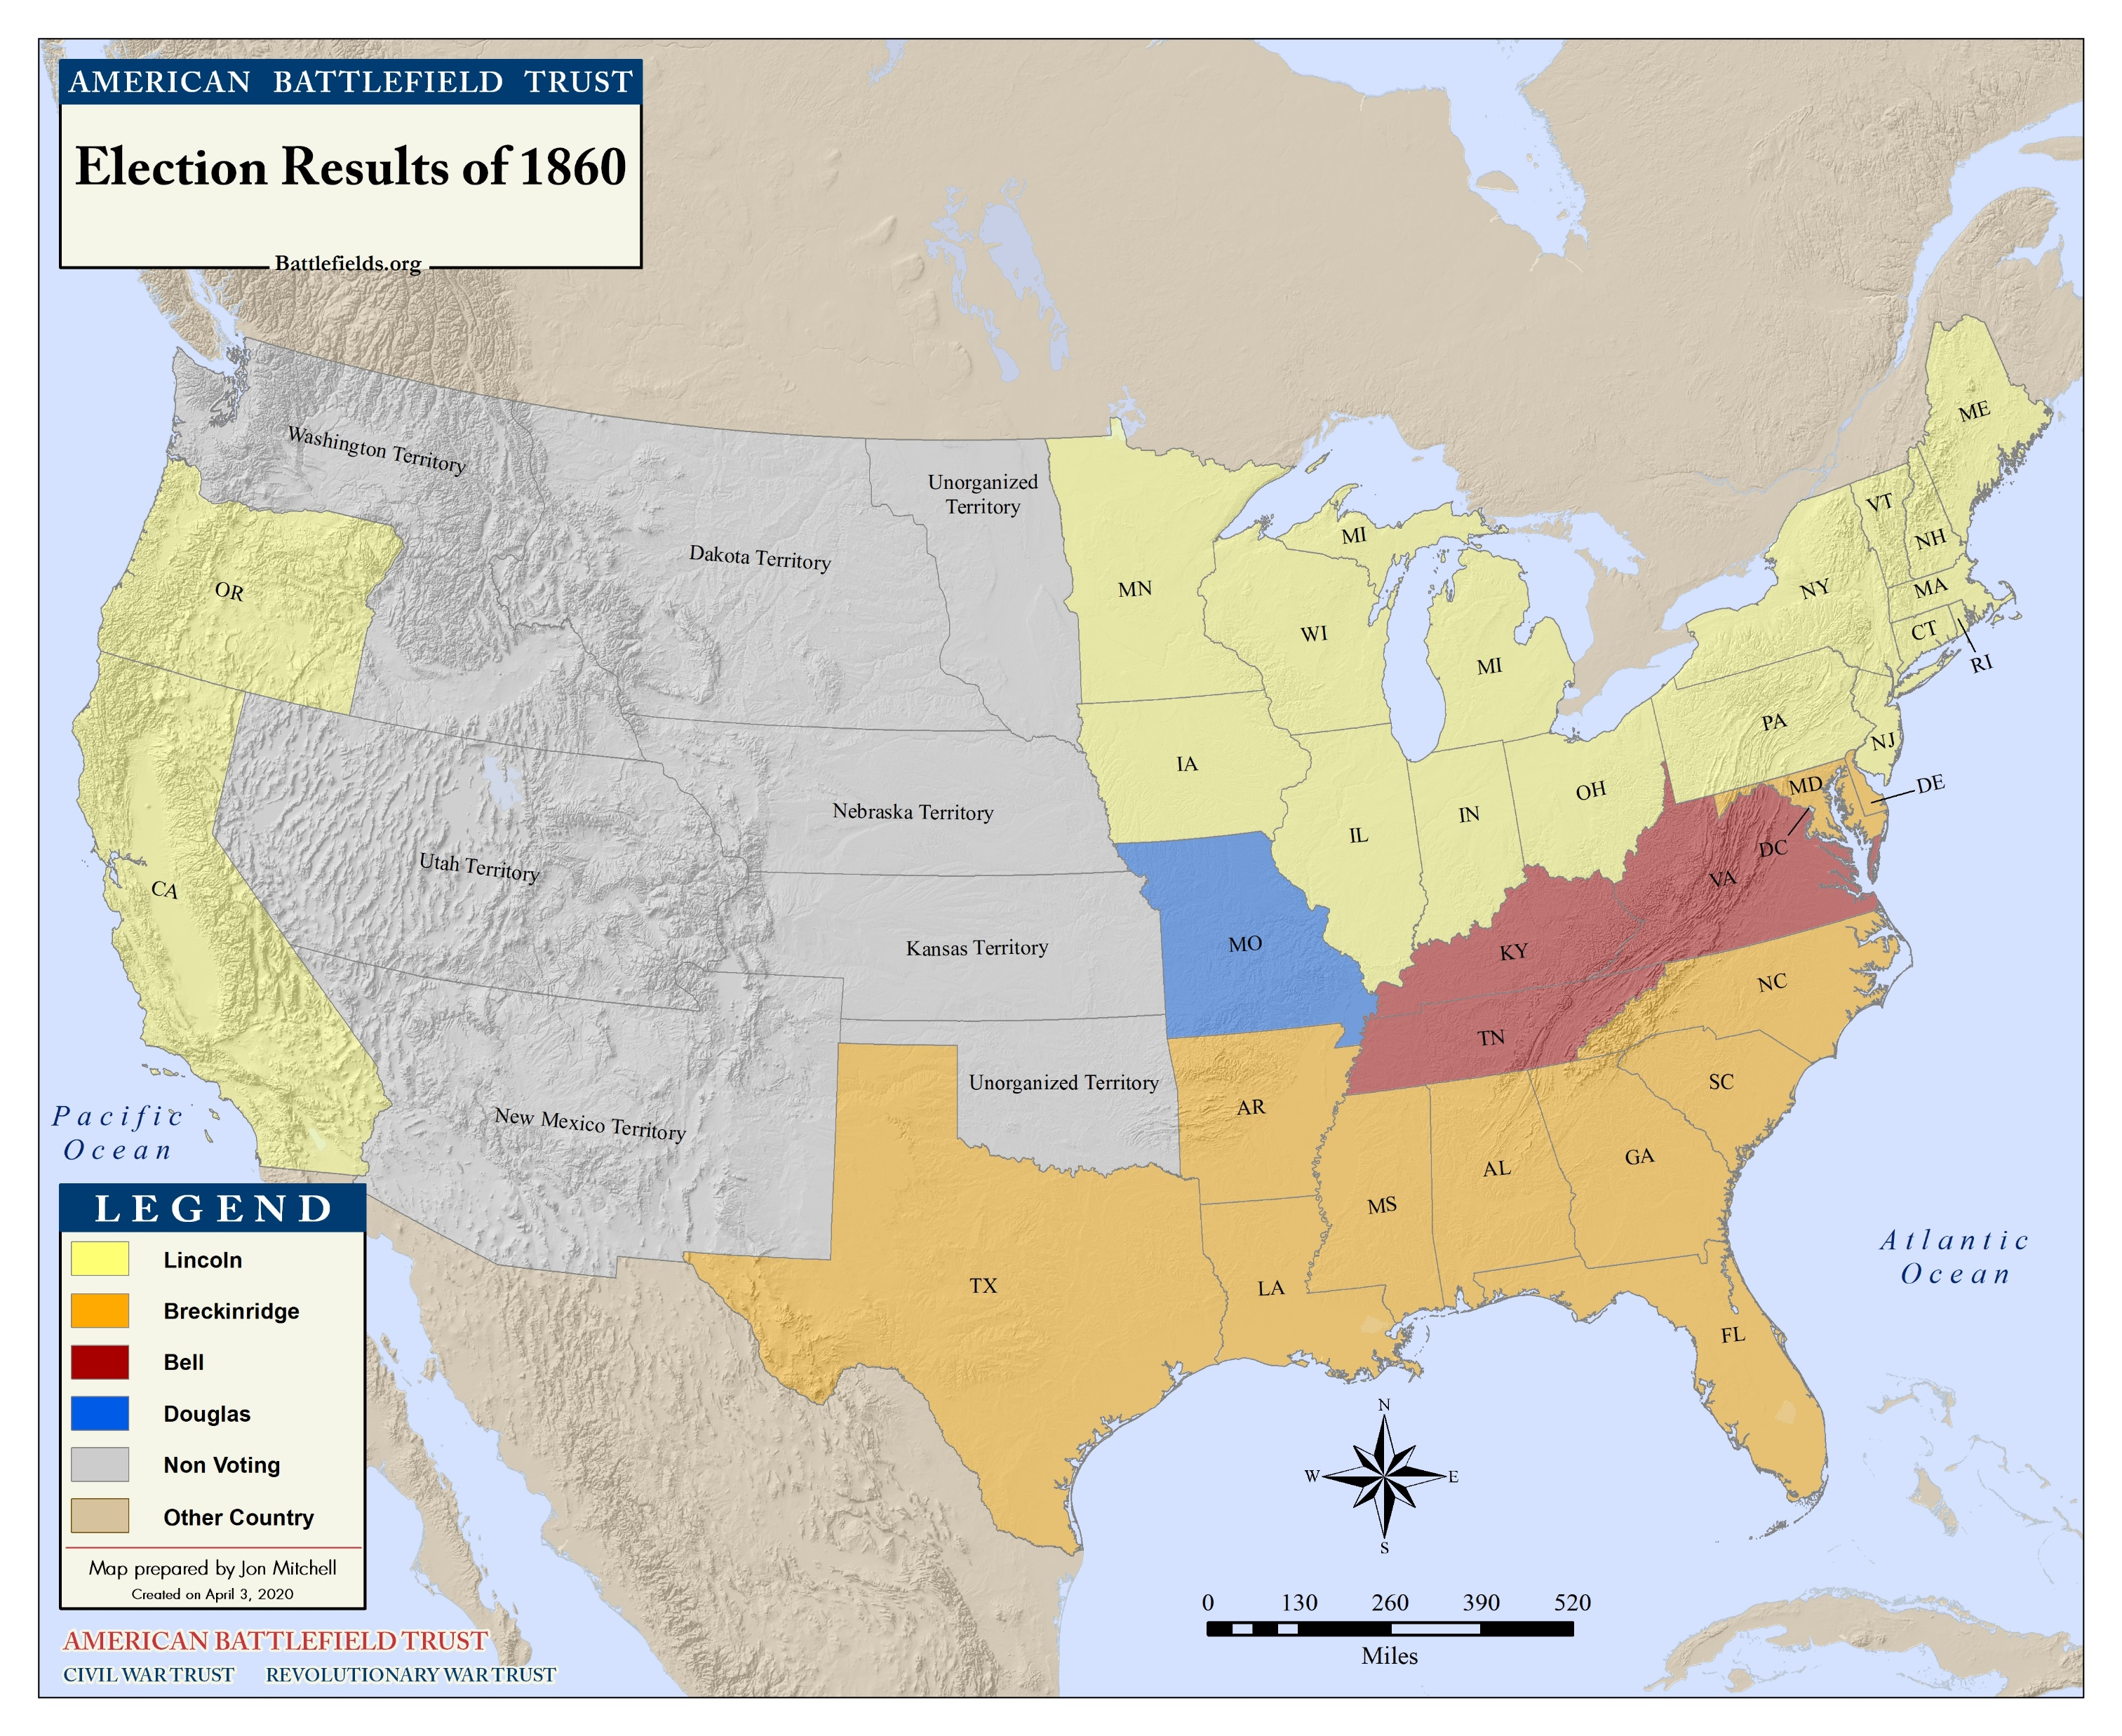
Lincoln Elected President
November 6, 1860

Slide 3
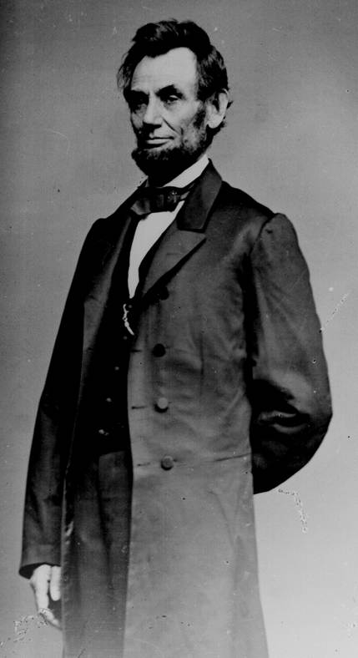
Lincoln Elected President
In the 1860 presidential race, four men ran for president – a northern Democrat, a southern Democrat, an Independent, and Lincoln, a Republican.
Due to the choice of 4 candidates, Lincoln, carrying the votes of the populous North, won.
Southerners became very fearful that the anti-slavery Republicans would try to change their way of life.

Slide 4
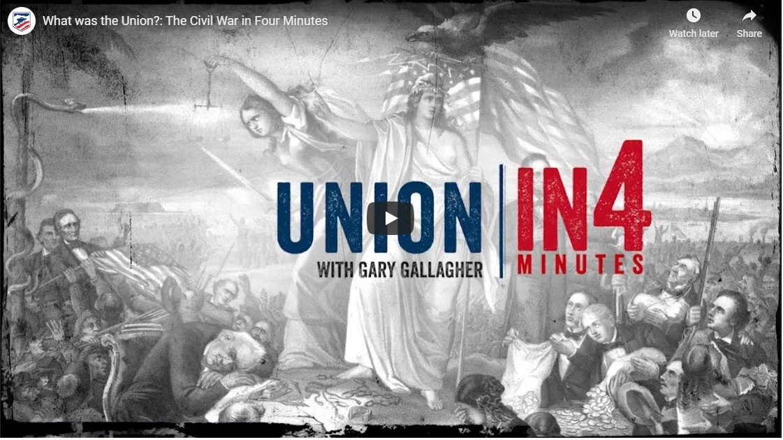
The Idea of Union

Slide 5
Excerpt, Civilian And Gazette Weekly
November 13, 1860, Galveston, Texas
The Governor [of South Carolina], “earnestly recommended that, in the event of Abraham Lincoln’s election to the Presidency, a convention for the people of this State be immediately called to consider and determine for themselves the mode and measure of redress.”
[The Governor stated the following]
"That the only alternative left, in my judgment, is the secession of South Carolina from the Federal Union. The indications of many of the Southern States justify the conclusion that the secession of South Carolina would be immediately followed, if not adopted simultaneously, by them, and ultimately by the entire South…. The State has, with great unanimity, declared that she has the right peaceably to secede, and no power on earth can rightfully prevent it.”

Slide 6
Secession of South Carolina
December 20, 1860
On December 20, 1860, South Carolina formally seceded from, or left, the Union.
South Carolina argued that the non-slaveholding states in the Union had violated the Constitution, specifically the fourth article, breaking agreed upon laws; therefore, South Carolina could leave the Union.
Within the next six weeks, six other states voted to secede.
The Confederate States of America was established.

Slide 7
Excerpt, Declaration of the Immediate Causes Which Induce and Justify the Secession of South Carolina from the Federal Union
A geographical line has been drawn across the Union, and all the States north of that line have united in the election of a man to the high office of President of the United States, whose opinions and purposes are hostile to slavery. He is to be entrusted with the administration of the common Government, because he has declared that that "Government cannot endure permanently half slave, half free," and that the public mind must rest in the belief that slavery is in the course of ultimate extinction.
The guaranties of the Constitution will then no longer exist; the equal rights of the States will be lost. The slaveholding States will no longer have the power of self-government, or self-protection, and the Federal Government will have become their enemy.

Slide 8
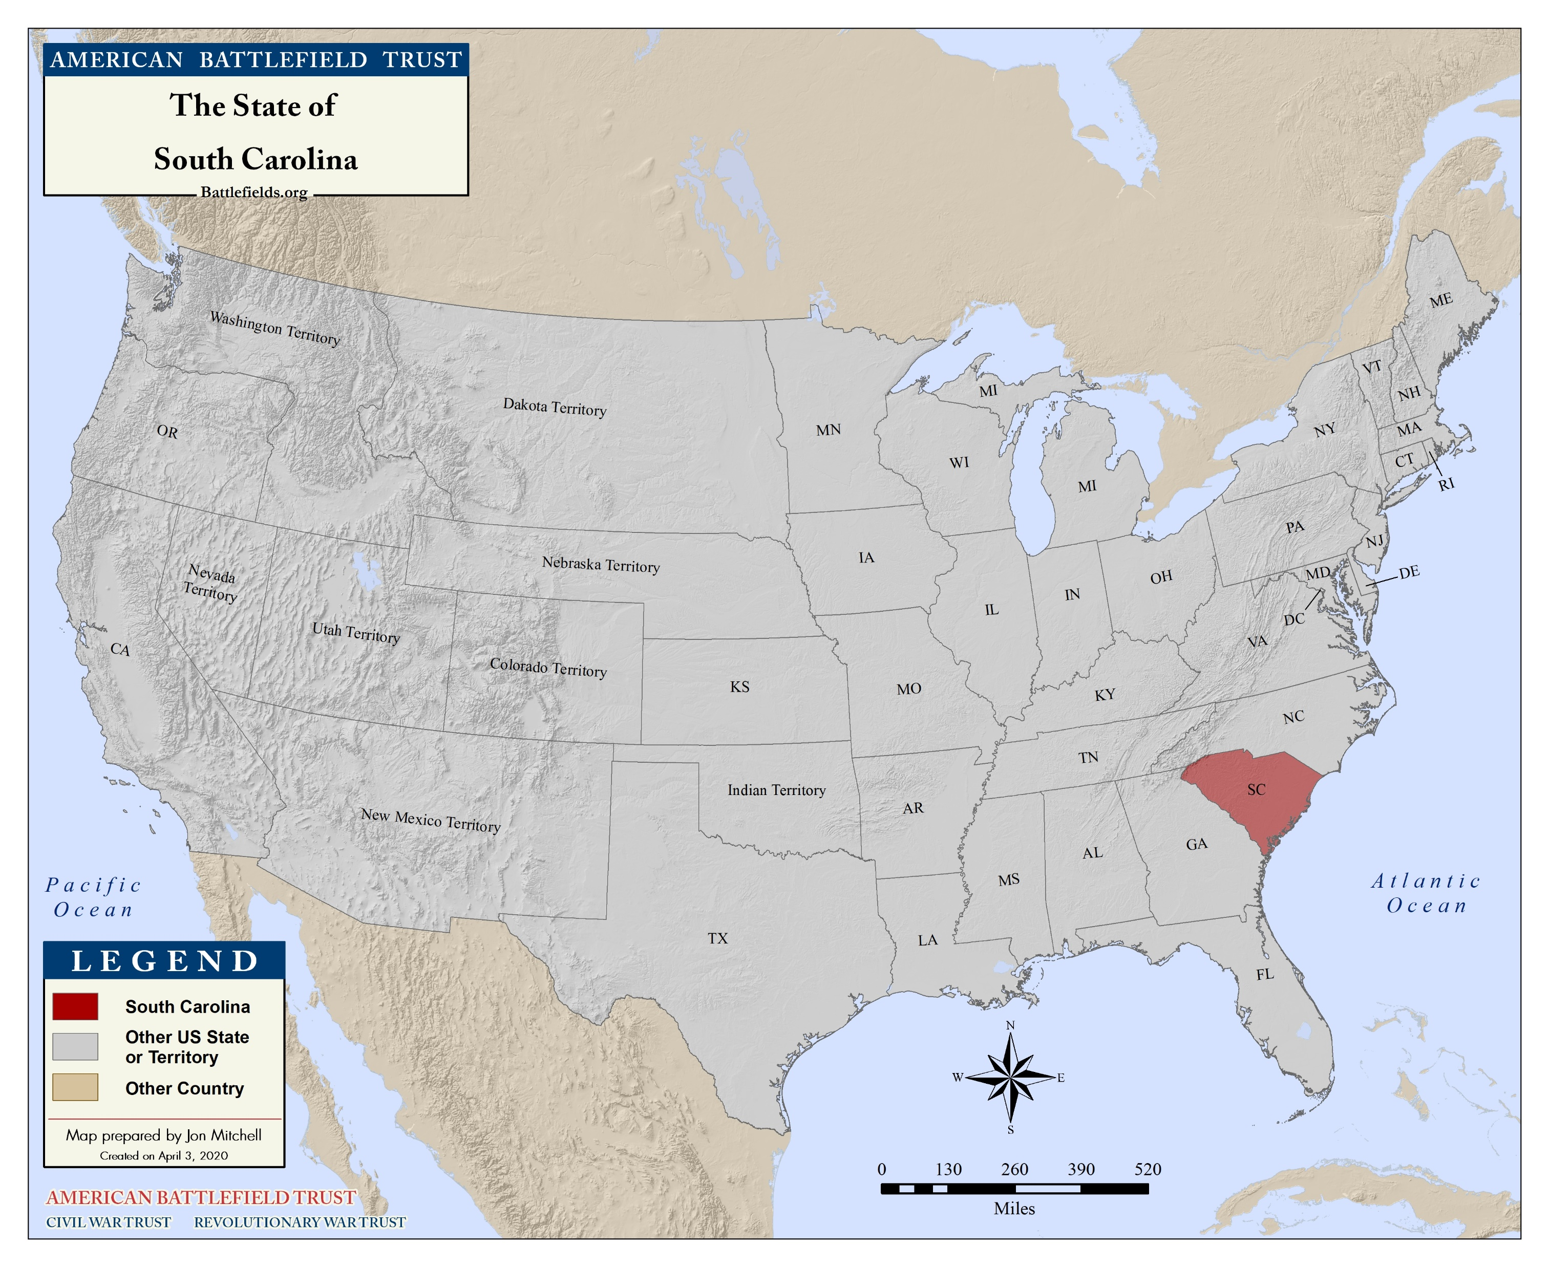
South Carolina Secedes
December 20, 1860

Slide 9
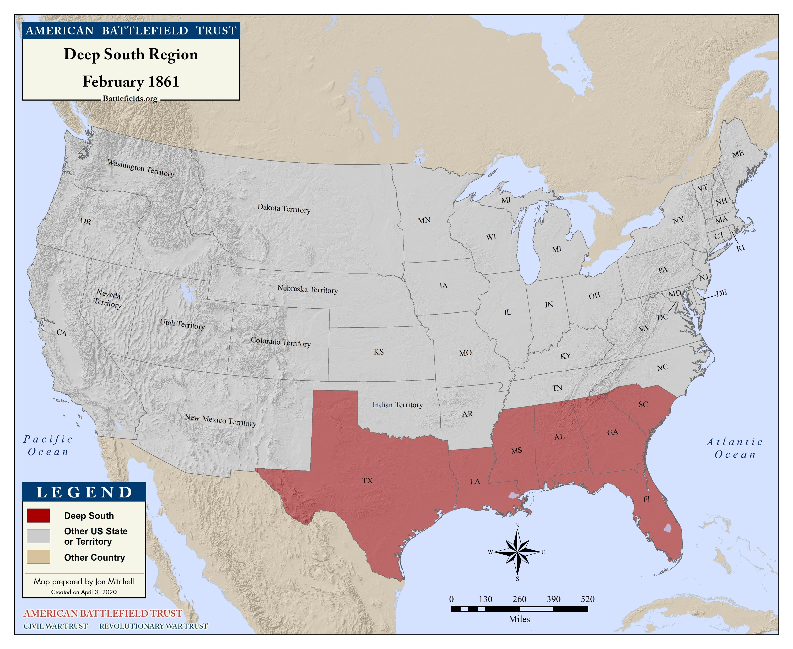
Secession
January & February, 1861

Slide 10
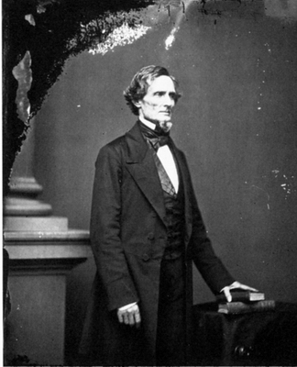
A President for the Confederacy
February 9, 1861
Jefferson Davis is chosen as the President of the Confederate States of America.
He will be elected that November.

Slide 11
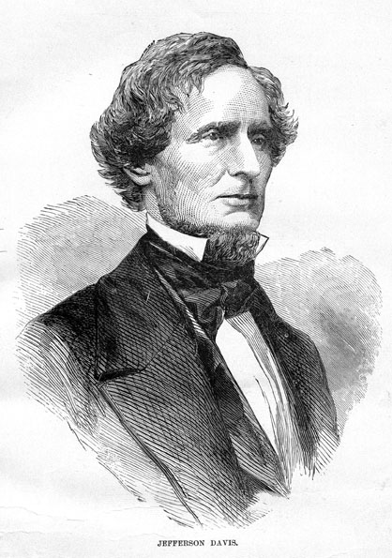
Except from the Inaugural Address
Jefferson Davis, President of the Confederate States of America
February 18, 1861
“I enter upon the duties of the office to which I have been chosen with the hope that the beginning of our career as a Confederacy may not be obstructed by hostile opposition to our enjoyment of the separate existence and independence which we have asserted, and, with the blessing of Providence, intend to maintain. Our present condition, achieved in a manner unprecedented in the history of nations, illustrates the American idea that governments rest upon the consent of the governed, and that it is the right of the people to alter or abolish governments whenever they become destructive of the ends for which they were established.”

Slide 12
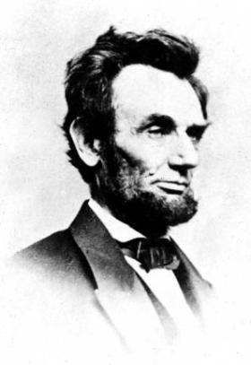
Except from the Inaugural Address
Abraham Lincoln, President of the United States of America
March 4, 1861
“In your hands, my dissatisfied fellow-countrymen, and not in mine, is the momentous issue of civil war. The Government will not assail you. You can have no conflict without being yourselves the aggressors. You have no oath registered in heaven to destroy the Government, while I shall have the most solemn one to ‘preserve, protect, and defend it.’”

Slide 13
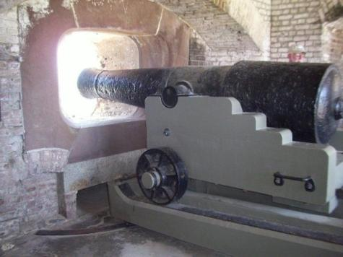
Fort Sumter
April 12, 1861
Confederate forces fired on the fort, which was unable to effectively fight back. The United States surrendered Fort Sumter, Union forces left the following day.
The firing upon Fort Sumter was the opening engagement of the American Civil War.

Slide 14
Excerpt, Surrender of Fort Sumter
Effect of the News at Richmond
April 15, 1861, Richmond Enquirer
The procession had swelled to about three thousand persons, by the time the column halted at the Tredegar Iron Works, to witness the raising of a large Southern Confederacy flag over the main building of the works, which was done by the employees of the establishment. Without delay, the flag was hauled up, the band playing the Marsellaise, and cannon (manufactured at the Tredegar for the use of the Confederate Government) thundered a welcome to the banner of the South.

Slide 15
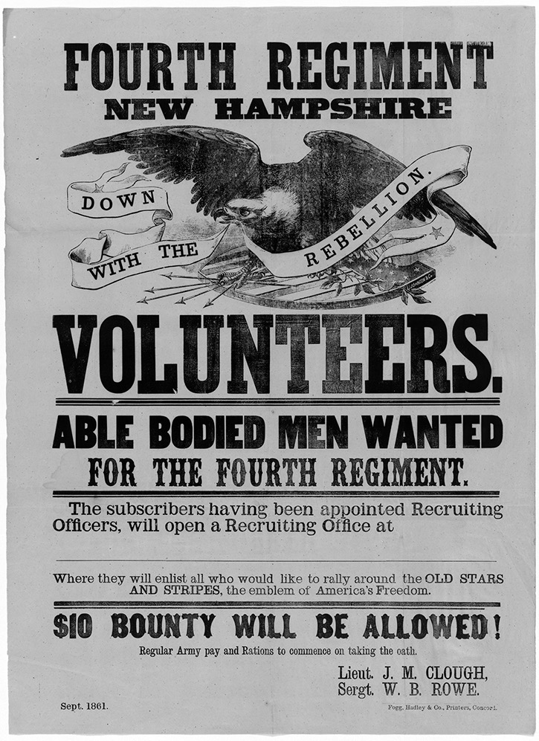
C A L L T O A R M S ! !
75,000 VOLUNTEERS WANTED
Washington, April 15.
Under the act of Congress for calling out the militia to execute the laws of the Union to suppress insurrection….
- Simon Cameron, Secretary of War

Slide 16
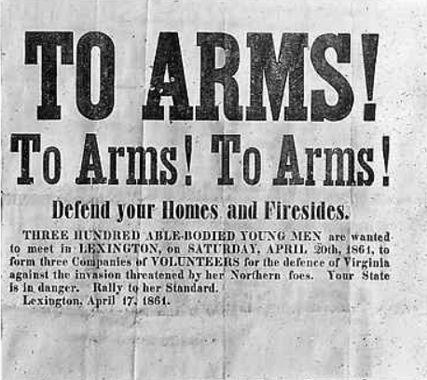
April 17, 1861
Notes:
Confederate call to arms printed in Lexington, Kentucky, asking for volunteers to go to war in Virginia. April 17, 1861. State Library, Richmond, Virginia.
New York State Archives. New York (State). Department of Education. Division of Visual Instruction. Instructional glass lantern slides, ca. 1856-1939. Series A3045-78, No. 3659
http://digitalcollections.archives.nysed.gov/index.php/Detail/Object/Show/object_id/1110

Slide 17
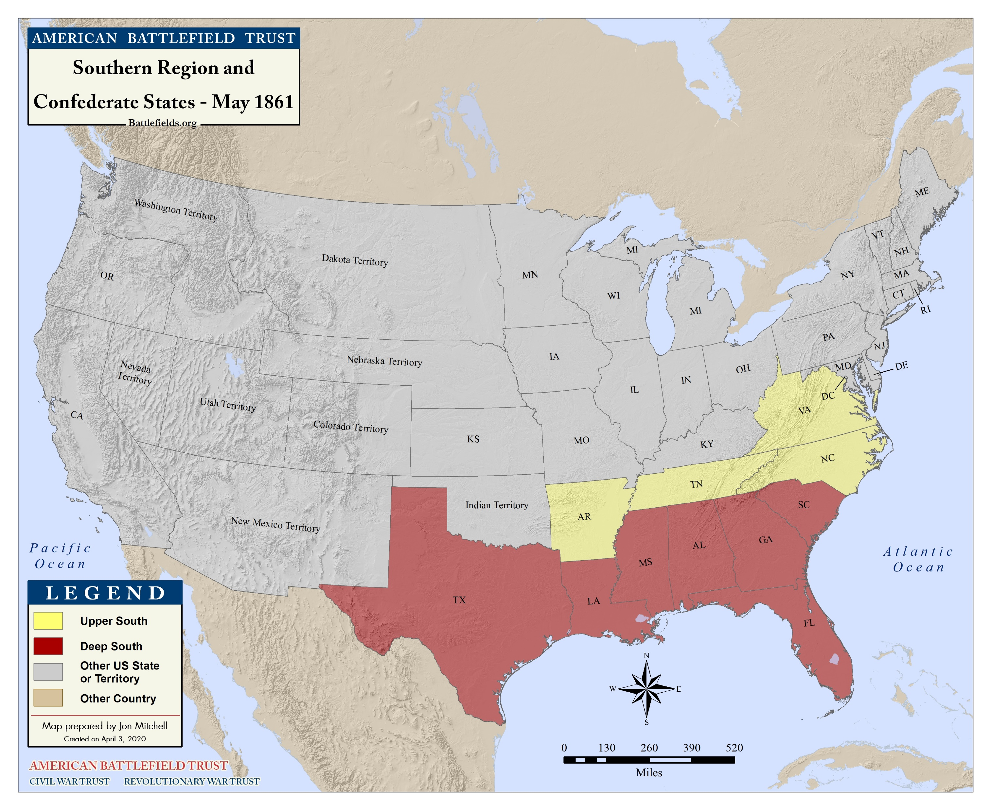
Secession
April to June 1861

Slide 18

Virginia Joins the Confederacy
April 17, 1861
Virginia joins the Confederate States
of America.
Richmond becomes the capital of the Confederacy.

Slide 19
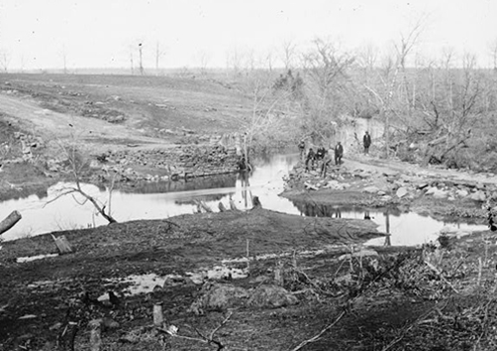
First Manassas (Bull Run)
July 21, 1861
The first major land battle
of the American Civil War,
The Battle of First Manassas, also known as Bull Run, was fought just outside of Washington D.C.

Slide 20
Excerpt, The New York Times
July 26, 1861, New York
Governor Morgan, it will be seen by his Proclamation, published in another column, has concluded, under the requisition of the President for more troops, to call for twenty-five thousand additional Volunteers, to serve for three years, or during the war.
It is expected at Fortress Monroe that Magruder, the rebel commander at Yorktown, emboldened by the success at Manassas Junction will make a demonstration in the direction of Hampton or Newport News. All our regiments there are now inside their entrenchments, and ready for him whenever he chooses to show himself.

